Slide 1



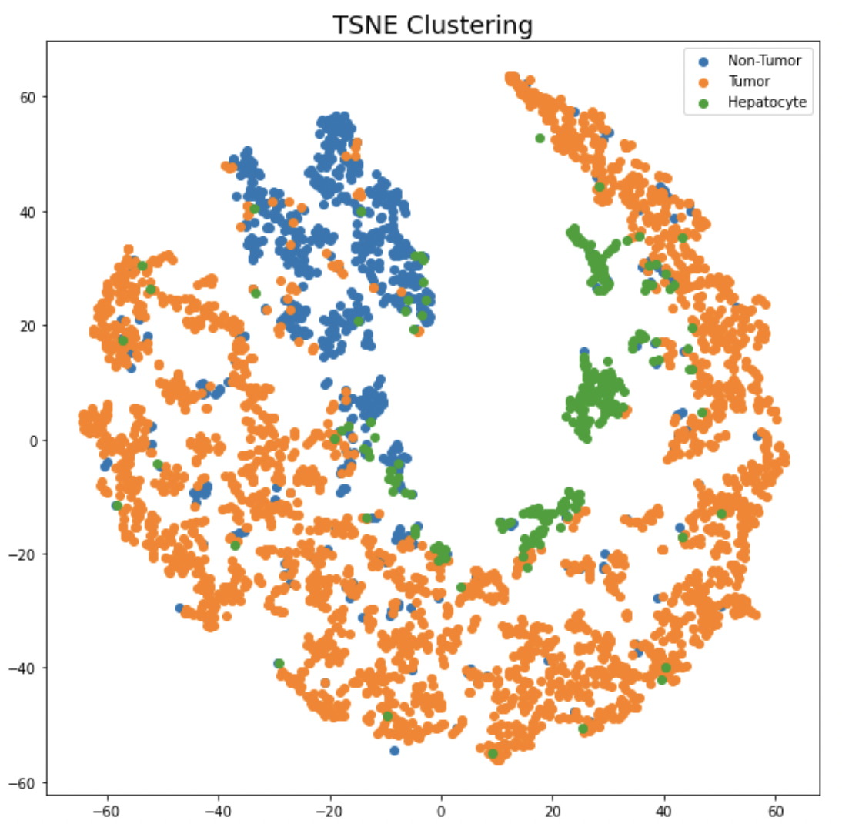
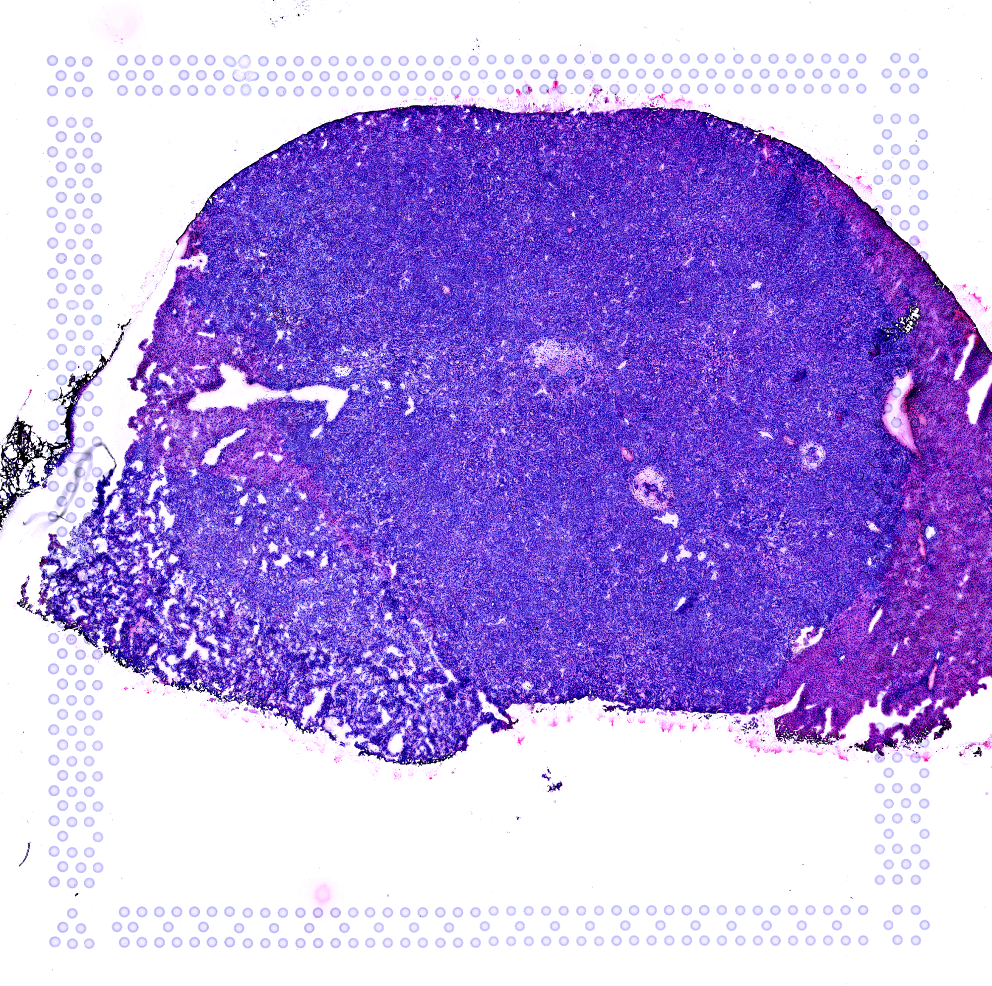
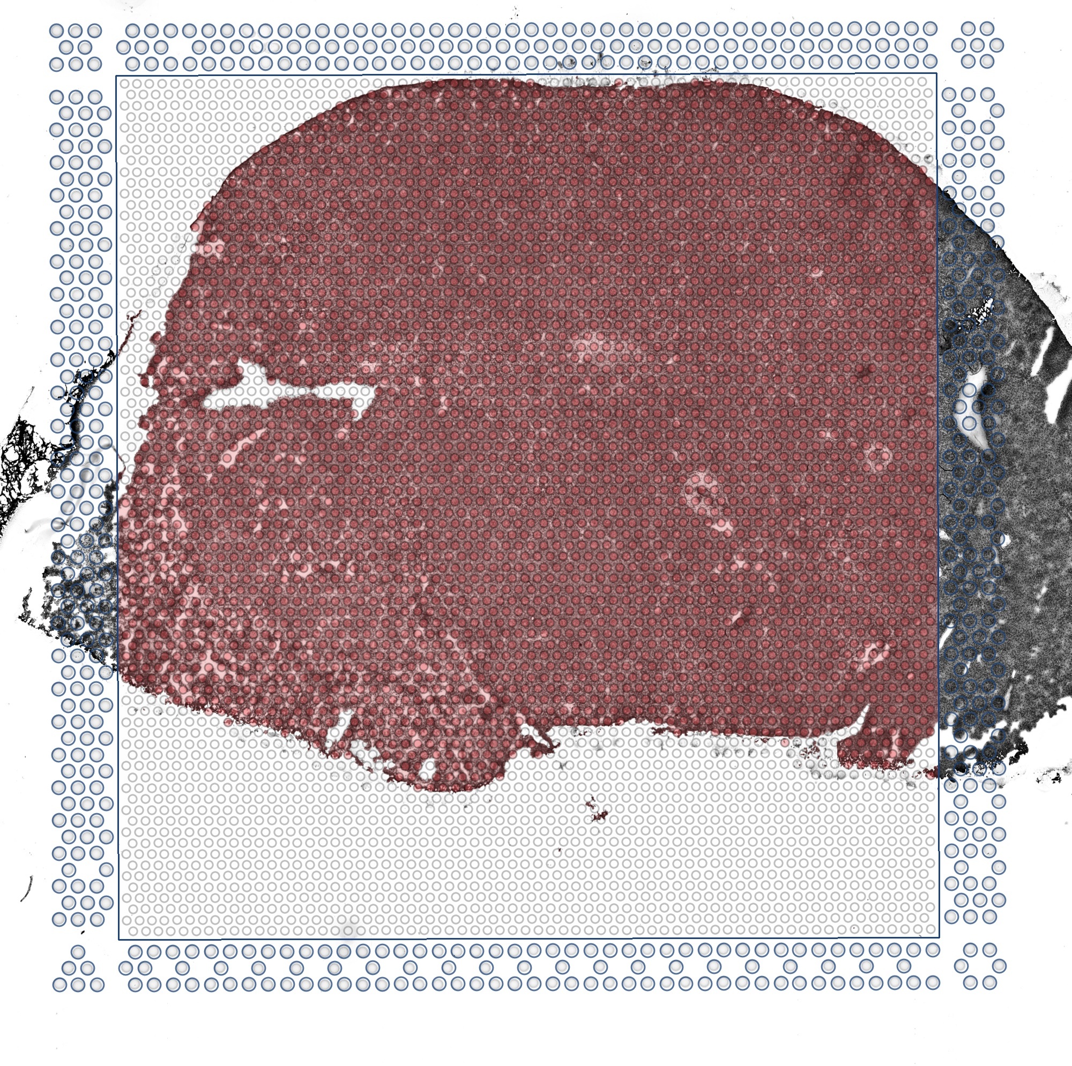
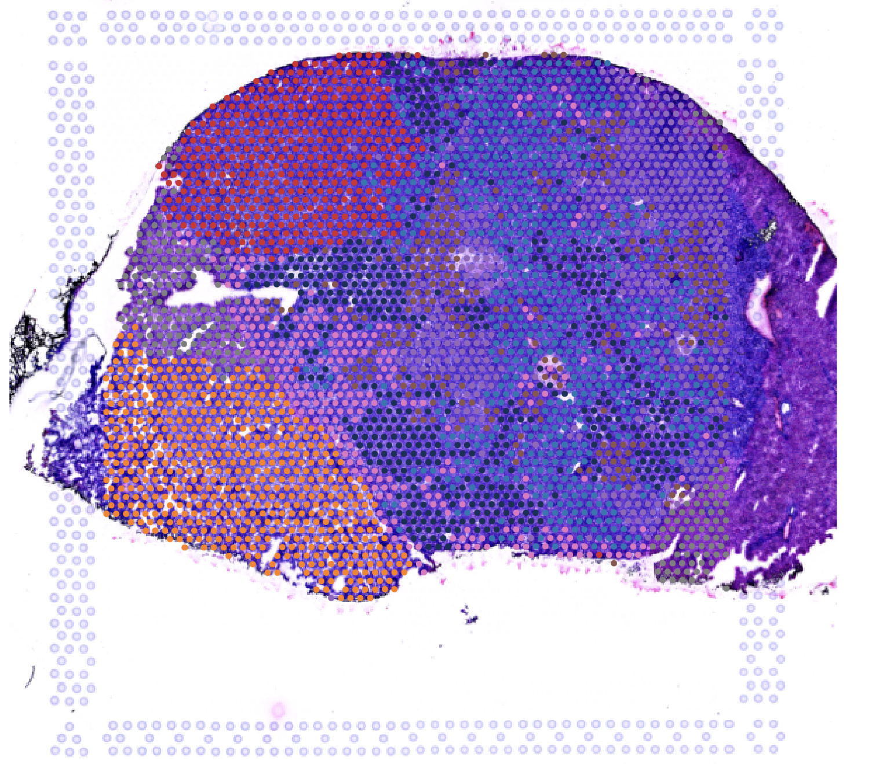
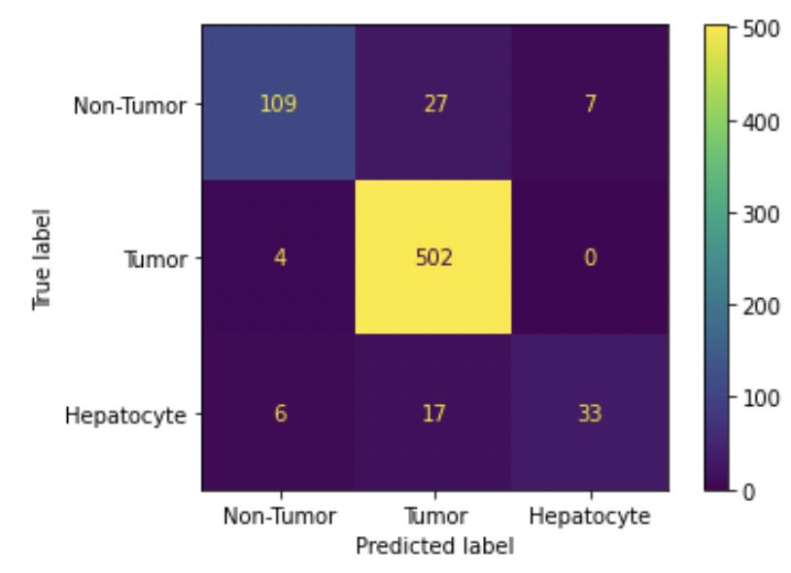
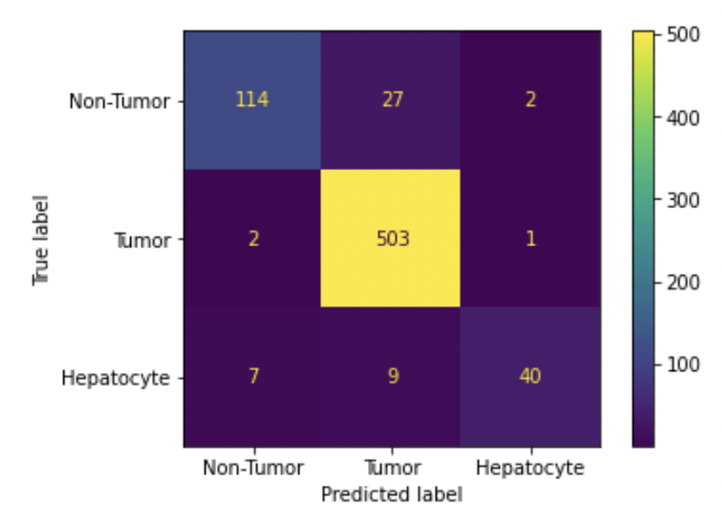
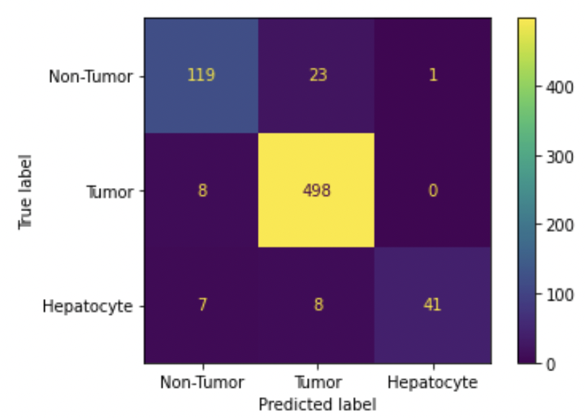
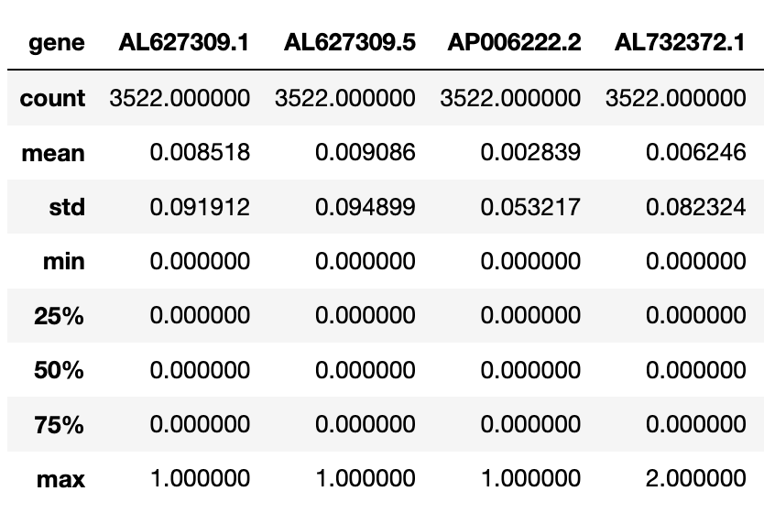
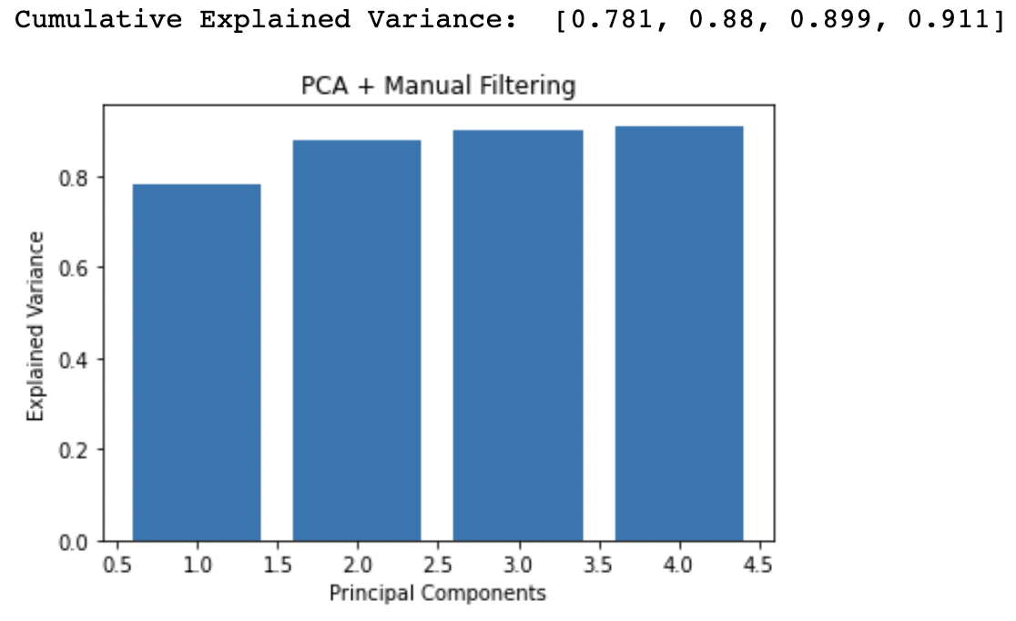
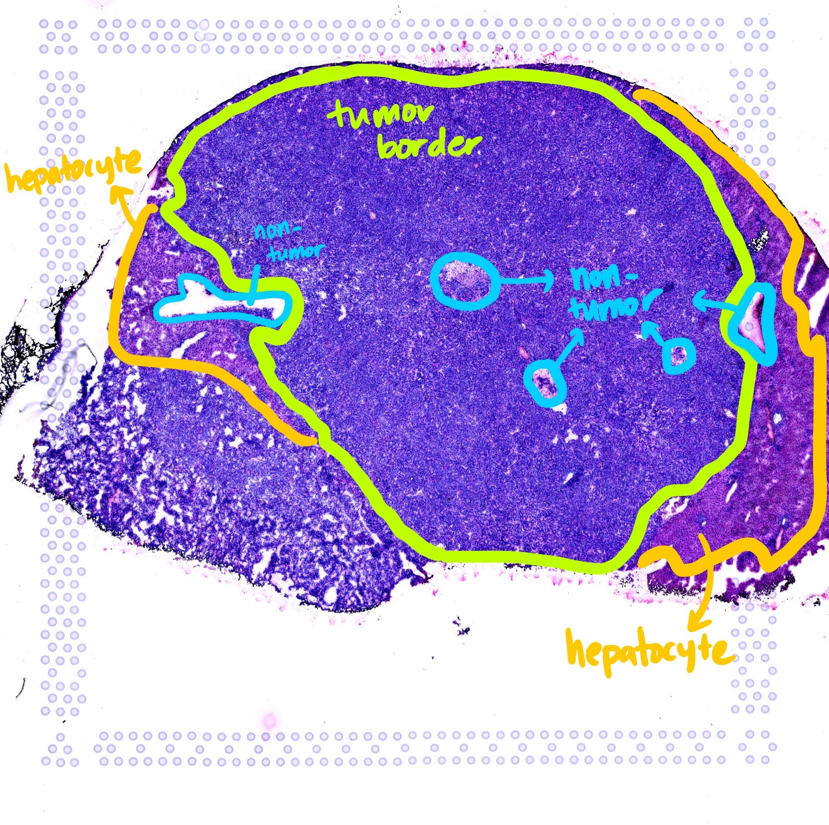
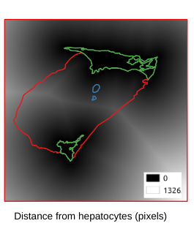
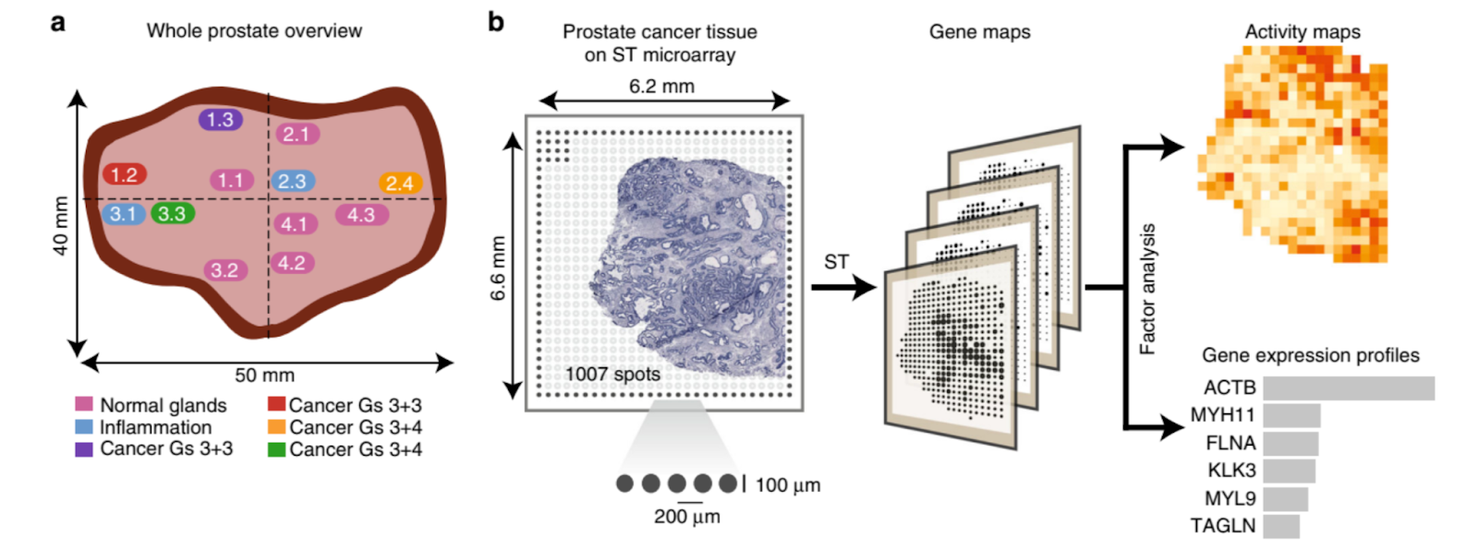

Spatial Analysis of Tumor Heterogeneity Using Machine Learning Techniques
Chancharik Mitra¹, Jin Young Yoo², Dr. Zeynep Madak-Erdogan², Dr. Aiman Soliman^{2,3}
¹University of California, Berkeley; ²University of Illinois, Urbana-Champaign, ³National Center for Supercomputing Applications
Award No.: 2050195
Digital Poster
Key Finding: SVMs and Random Forest Classifiers can effectively analyze tumor heterogeneity by segmenting tumor, non-tumor, and hepatocyte regions.
Abstract
Method
Results & Conclusion
As defined by the National Cancer Institute, tumor heterogeneity describes how tumor cells of the same cancer type can exhibit differences from one another [1].
This property serves as a serious obstacle to effective cancer treatments and therapies [2].
We propose the use of spatial transcriptomics, a method of RNA sequencing that captures gene expression over entire tumor tissue samples [3]. Specifically, we analyze tumor heterogeneity of metastatic ER positive breast cancer tissue from liver samples.
Ultimately, we find that spatial analysis and machine learning techniques can effectively analyze tumor heterogeneity by segmenting key regions and identifying notable gene expression patterns.
Tumor vs. Non-Tumor Acc. (F8_37) | Tumor vs. Non-Tumor vs. Hepatocyte Acc. (F8_37)
86.8% | 91.3%
93.5% | 93.2%
93.9% | 93.3%
L.R.
Using 10X Genomics Visium Spaceranger Pipeline
1. Data Preparation
S.V.M.
R.F.C.
Confusion Matrices
Fresh Frozen Tissue Sample
Establish Coordinates
Perform UMI Counts
2. Data Preprocessing
Logistic Regression
Support Vector Machine
Random Forest Classifier
Related Research
ML methods are effective in deriving insight about tumor heterogeneity using spatial gene expression data.
A review of research focused on spatial analysis of tumor ecology found effective use of macroecological statistical methods for analyzing the microenvironment of tumors, including predatory, mutualistic, commensal, and parasitic relationships between normal, cancer, and immune cells [4].
A separate study created spatial maps of prostate cancer samples to delineate cancer foci using gene expression gradients rather than histological factors [5].
Future Work
Generate Summary Statistics
PCA + Manual Filtering
Analyzing ML methods for interpretability (e.g., RPL41)
Spatial Features:
Deep Learning Methods:
Logistic Regression
Autoencoder Embedding
UNET
DINO
Attention Methods
Support Vector Machine
3. ML Analysis
Random Forest Classifier
References
[1] NCI Dictionary of Cancer terms. National Cancer Institute. (n.d.). Retrieved July 14, 2022, from https://www.cancer.gov/publications/dictionaries/cancer-terms/def/tumor-heterogeneity
[2] Janku F. Tumor heterogeneity in the clinic: is it a real problem? Ther Adv Med Oncol. 2014 Mar;6(2):43-51. doi: 10.1177/1758834013517414. PMID: 24587830; PMCID: PMC3932055.
[3] Marx, V. Method of the Year: spatially resolved transcriptomics. Nat Methods 18, 9–14 (2021). https://doi.org/10.1038/s41592-020-01033-y
[4]Sidra Nawaz, Yinyin Yuan, Computational pathology: Exploring the spatial dimension of tumor ecology, Cancer Letters, Volume 380, Issue 1, 2016, Pages 296-303, ISSN 0304-3835, https://doi.org/10.1016/j.canlet.2015.11.018.
[5]Berglund, E., Maaskola, J., Schultz, N. et al. Spatial maps of prostate cancer transcriptomes reveal an unexplored landscape of heterogeneity. Nat Commun 9, 2419 (2018). https://doi.org/10.1038/s41467-018-04724-5
t-SNE
Gene Expression Activity Map Pipeline for Prostate Cancer Samples [5]
Convert Annotations to Target Vectors
Classifying Tissue Coordinates

Slide 2
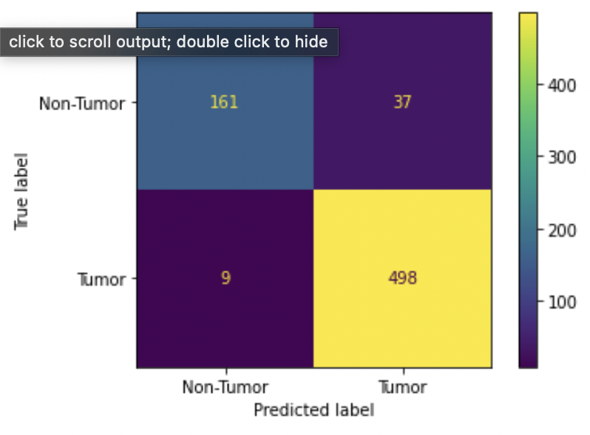
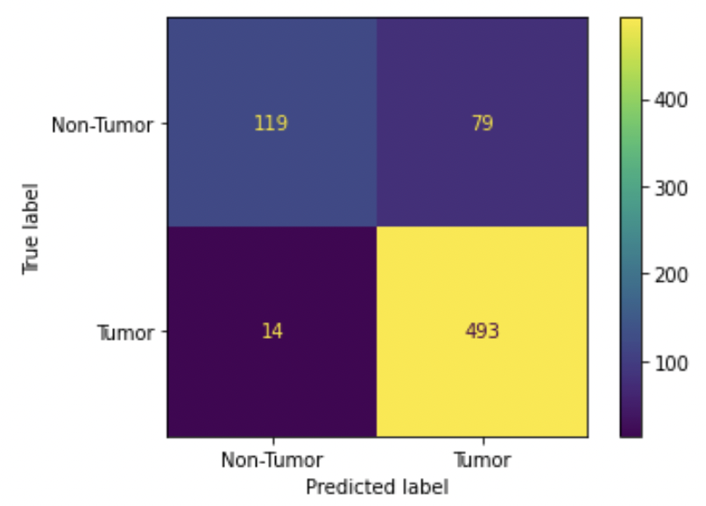
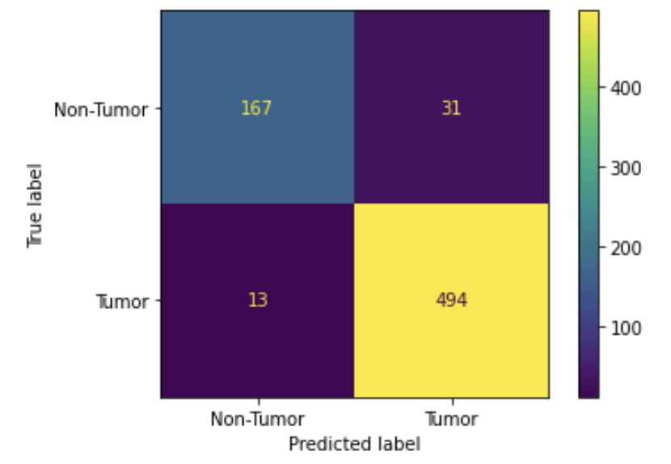
Supplementary Plots

